Slide 1
DeepSpeedStudy Day1
Simo Ryu
KAIST, Naver Cloud

Slide 2
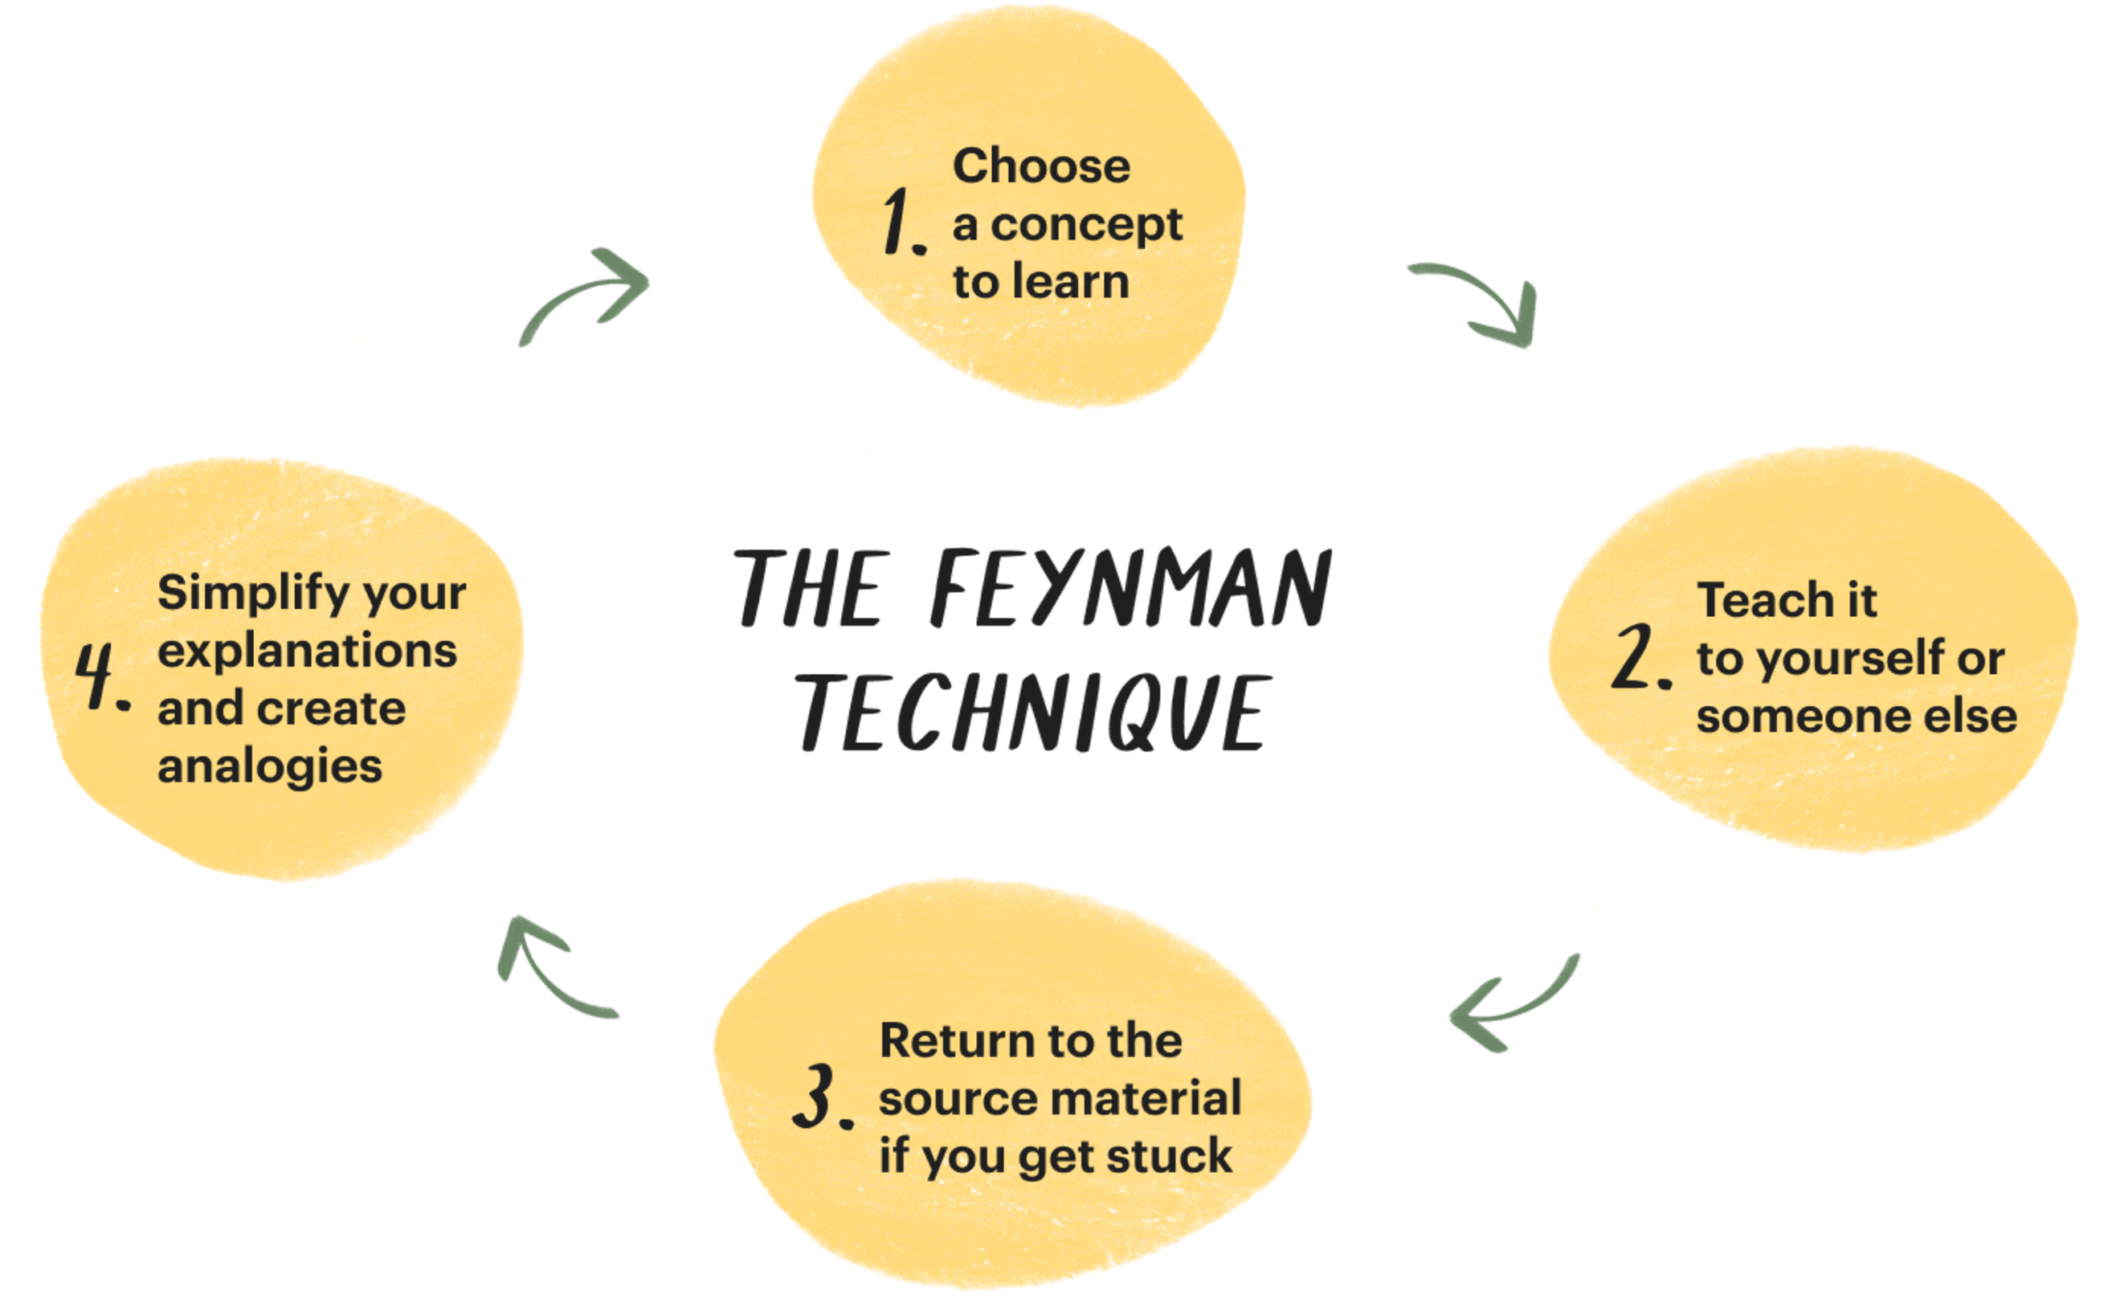
-1. Why should you do this?
1. For your own good:

Slide 3

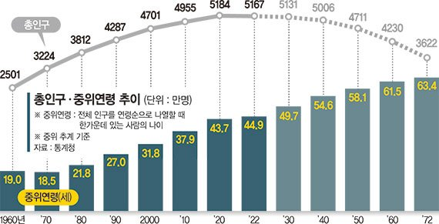

2. For sake of our country
Lack of real agents for national level productivity
Gap must be filled with artificial agents… that’s our job
LLM

Slide 4
3. For sake of humanity
We are planning to record each sessions, and make the resource public
World needs more material on DeepSpeed (and FSDP in general)

Slide 5
0. Review : Pytorch Internals
Deepspeed is essentially “wrapper around pytorch”
This means we need to know about torch in-depth
Luckily, torch is not dark magic
-

Slide 6
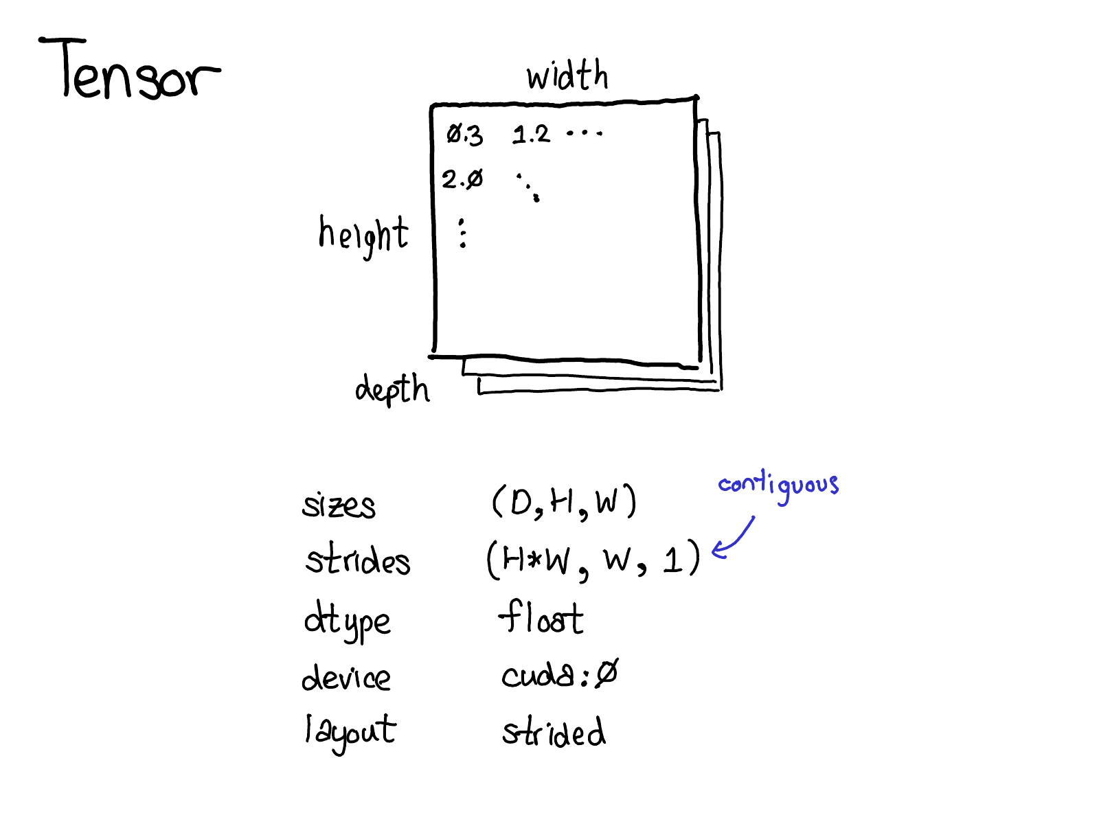
Tensor & Strides
Size
Strides
Dtype
Device
Layout *

Slide 7
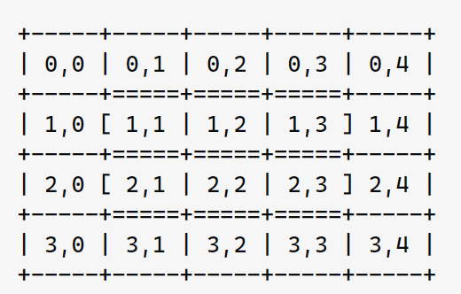
Strides?
Stride tells you : how much should we move in physical memory, to get to next element?
Q: What is the stride of 1-dim for next tensor array?
int array[4][5]:

Slide 8
Autograd:
tools/autograd (https://github.com/pytorch/pytorch/blob/main/tools/autograd/derivatives.yaml)
torch/autograd
torch/csrc/autograd

Slide 9
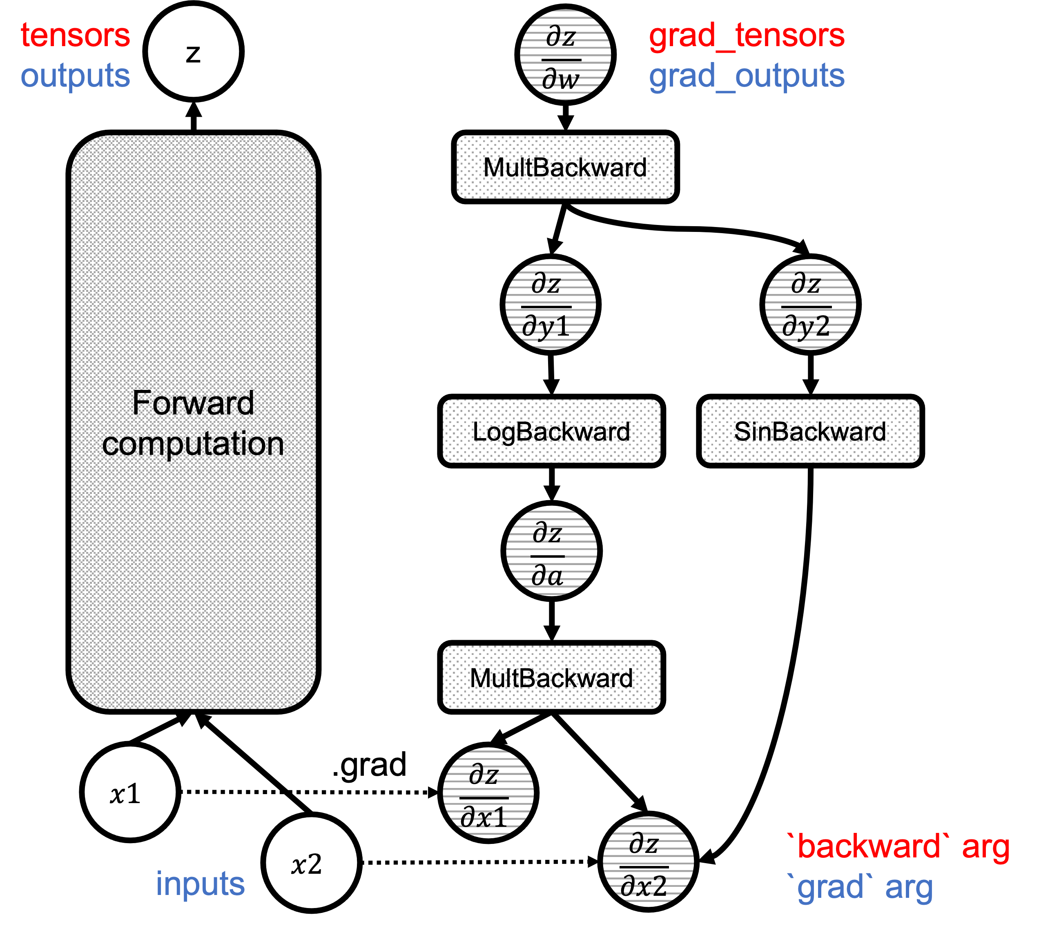
What Happens when Calling backward()/grad() from Python
When .backward() is invoked on a tensor, it essentially calls torch.autograd.backward(), which checks arguments and calls the autograd engine at the C++ layer.
Can also just do .grad()

Slide 10
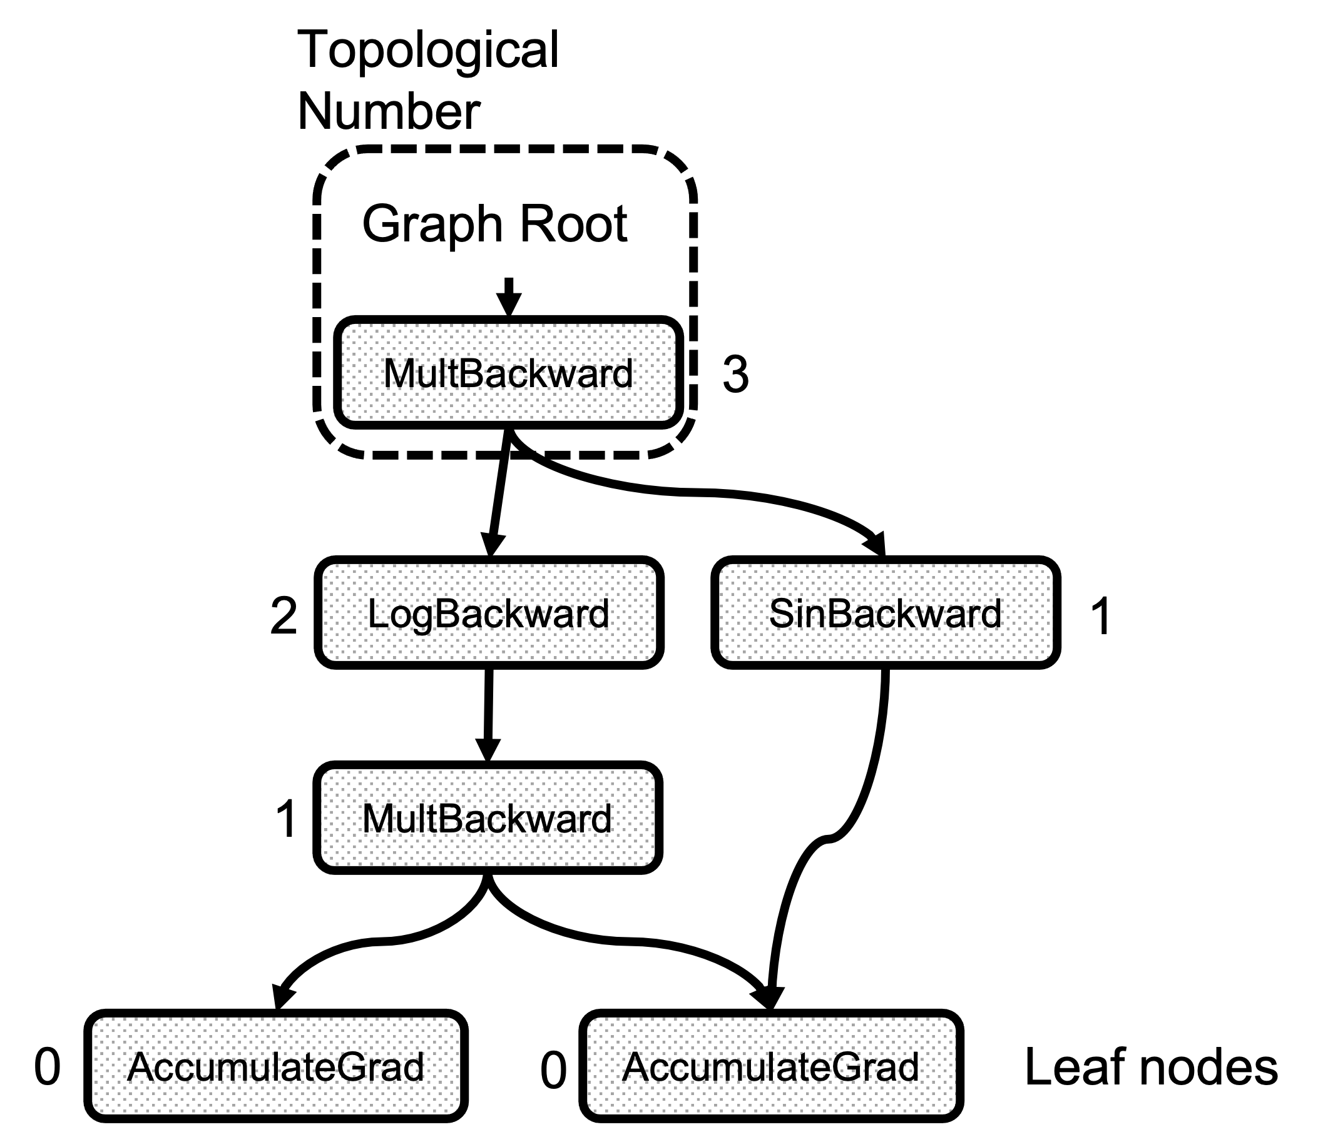
Topological Number
Topo(x) < topo(y):
: No path from x to y.

Slide 11
PyObject *THPEngine_run_backward
PyObject *THPEngine_run_backward(PyObject *self, PyObject *args, PyObject *kwargs)
{
// Prepare arguments
for(const auto i : c10::irange(num_tensors)) {
// Check that the tensors require gradients
}
std::vector<Edge> output_edges;
if (inputs != nullptr) {
// Prepare outputs
} {
// Calls the actual autograd engine
pybind11::gil_scoped_release no_gil;
outputs = engine.execute(roots, grads, keep_graph, create_graph, accumulate_grad, output_edges);
}
// Clean up and finish
}

Slide 12
DeepSpeed

Slide 13
DeepSpeed, What is it?
It aims to have 0 redundancy when doing data- parallelism training
from deepspeed import initialize
model = ...
optimizer = ...
model, optimizer, train_loader, _ = initialize(model=model, optimizer=optimizer, ...)

Slide 14
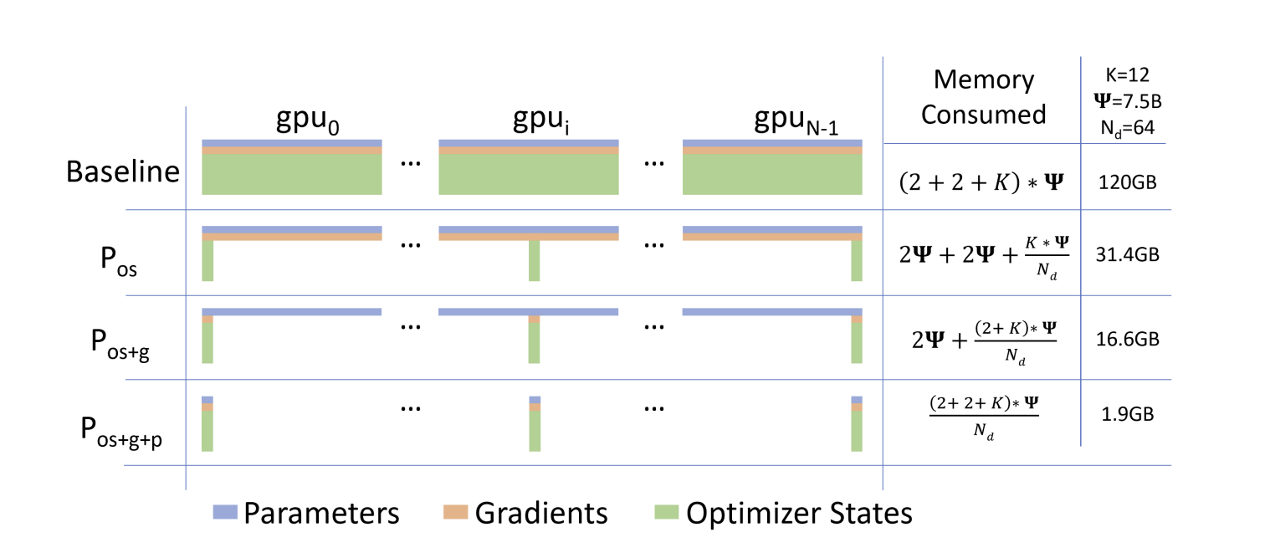
When doing DP, we have a lot of redundant information across device.
This can obviously be removed.

Slide 15
Where is all my memory?
Model States: Optimizer States, Gradients and Parameters
Residual Consumption : Activations, Temporary buffers, Fragmentation
ZeRO aims to mitigate both cases. (For Activations : Mainly because training is compute-bounded)

Slide 16
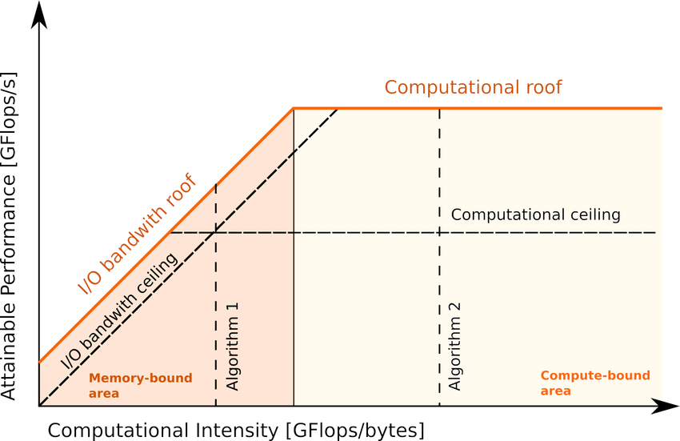




Memory-Compute boundedness
improves as memory throughput improves
improves as compute improves

Slide 17
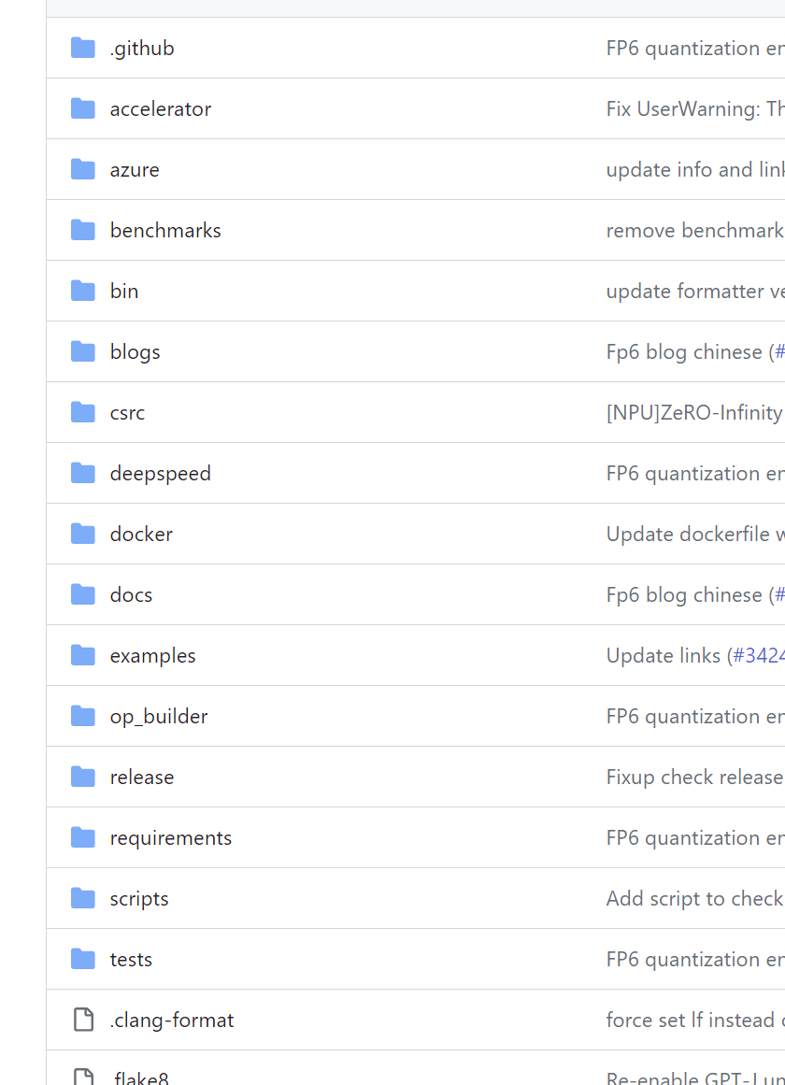
Sounds nic. Code plz?
Whoa! that’s a lot of code

Slide 18
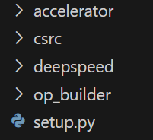
In the end… we only have 4 important folders
accelerator (not much)
csrc
deepspeed
op_builder
So actually 3.

Slide 19
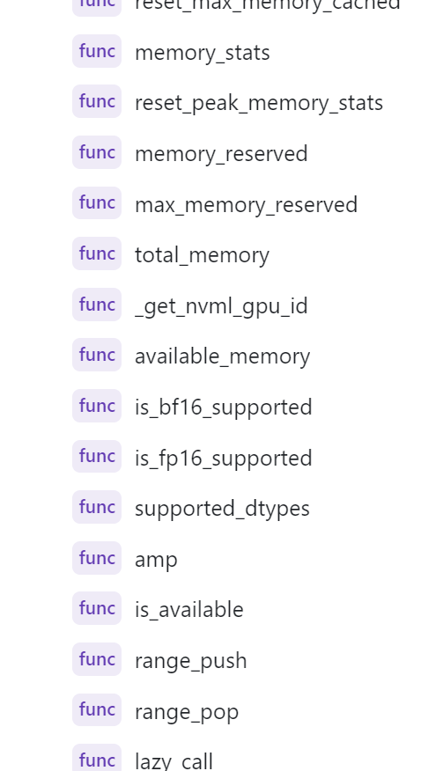
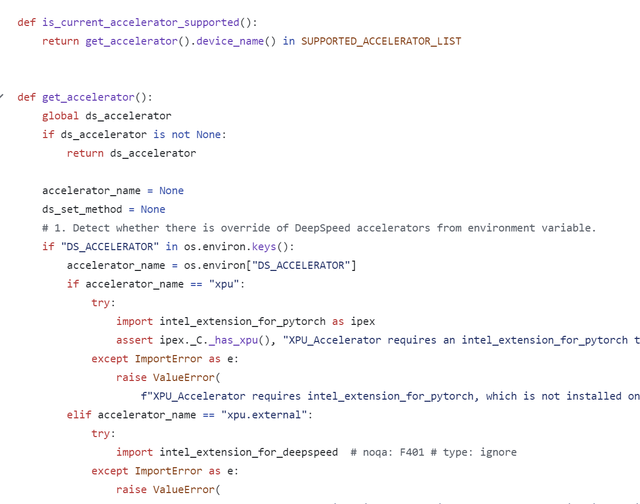
Wait what’s in the accelerator?
Essentially, device abstraction.
Abstracts away CPU, CUDA, NPU.. All in one place.
Lets not touch this abstraction.

Slide 20
/CSRC
bunch of fused kernels cuda codes..

Slide 21
/op_builder

Slide 22
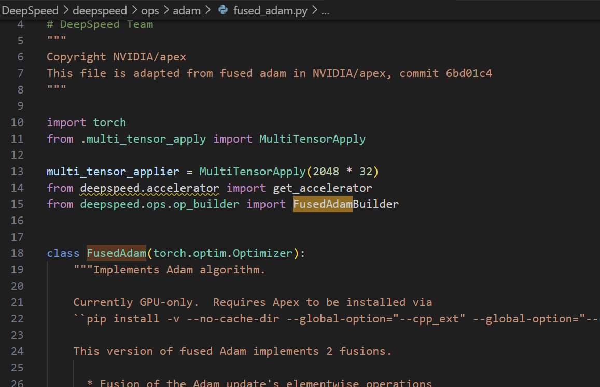
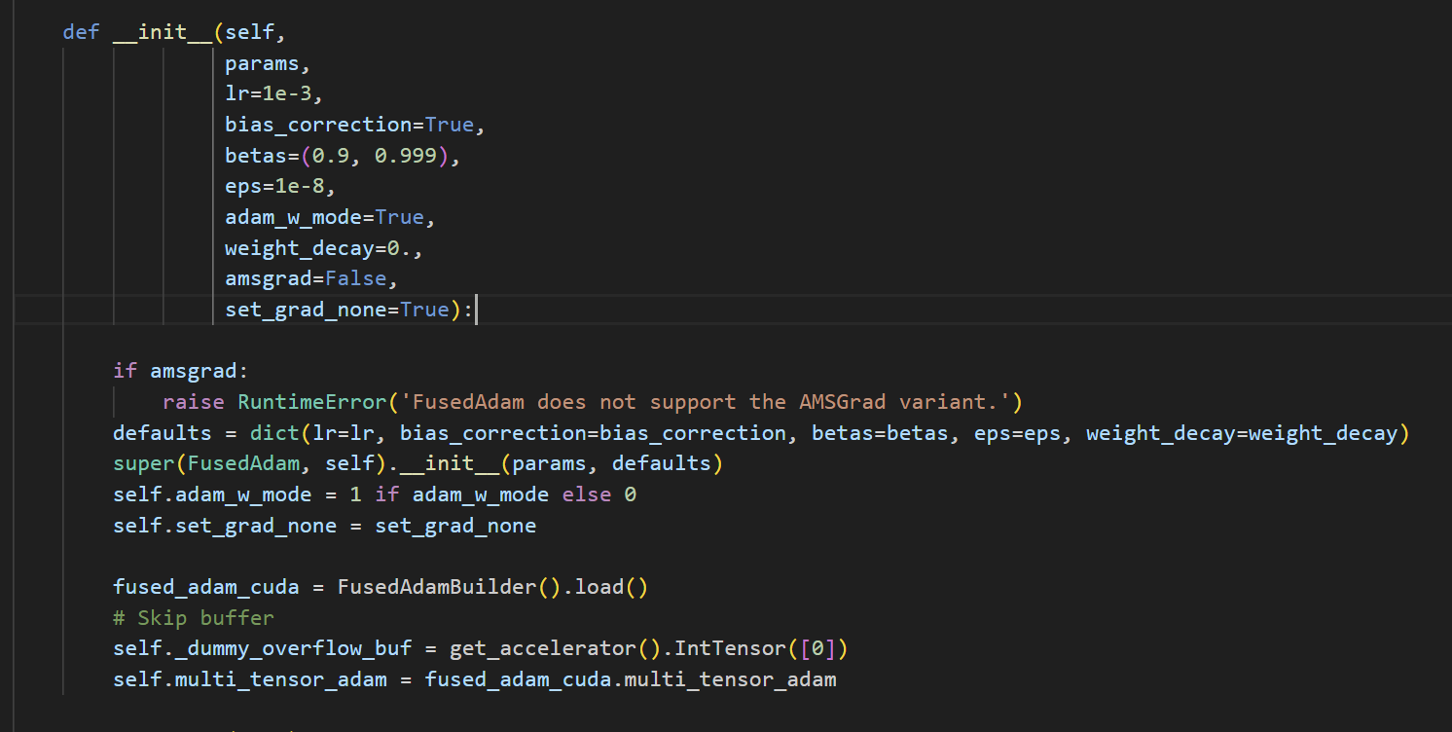
Let’s see how op_builder works,
When we call FusedAdam:
It calls op_builder.

Slide 23
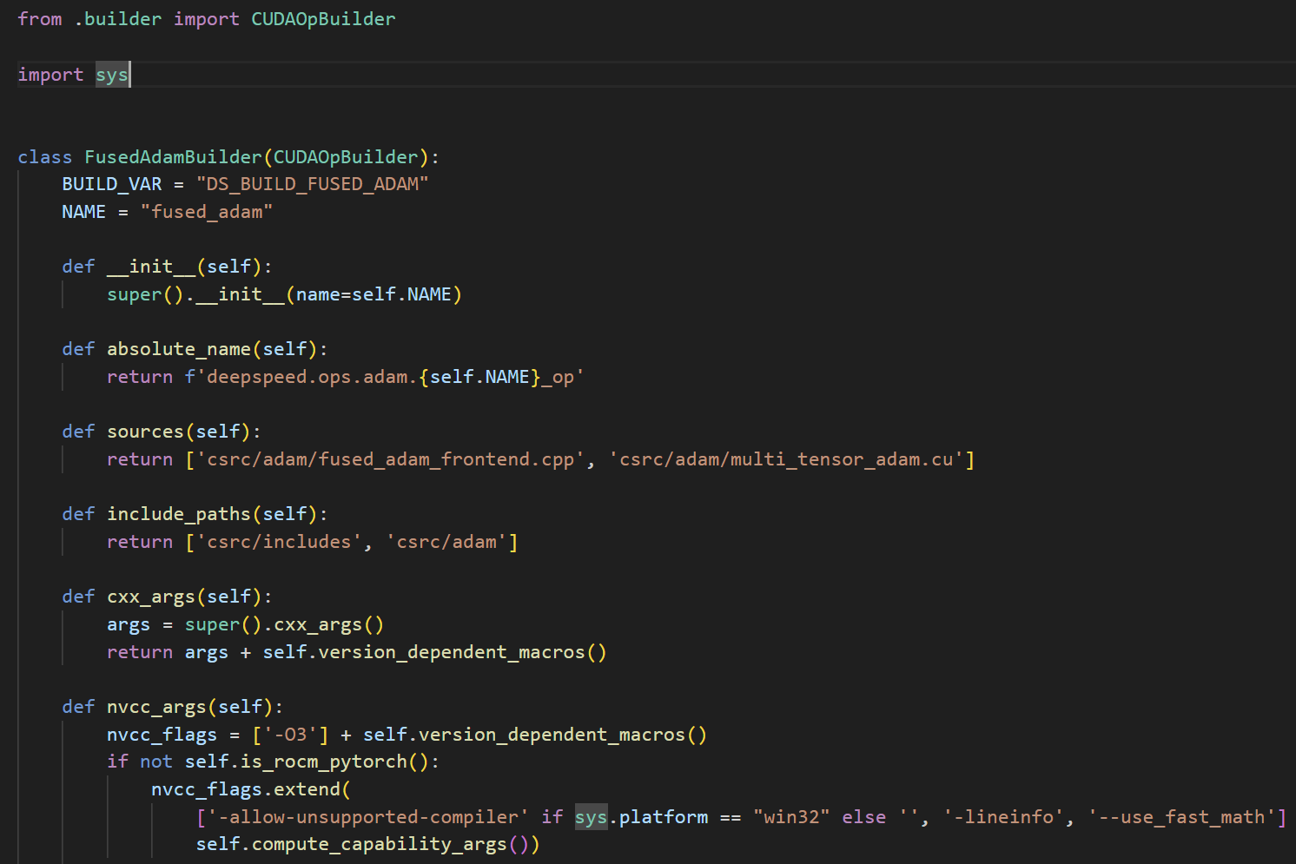
Opbuilder will build the FusedAdam, once called. And save it `somewhere`.

Slide 24
/deepspeed
So here we are, just with deepspeed folder.
Lets keep the big picture, remove everything else.

Slide 25
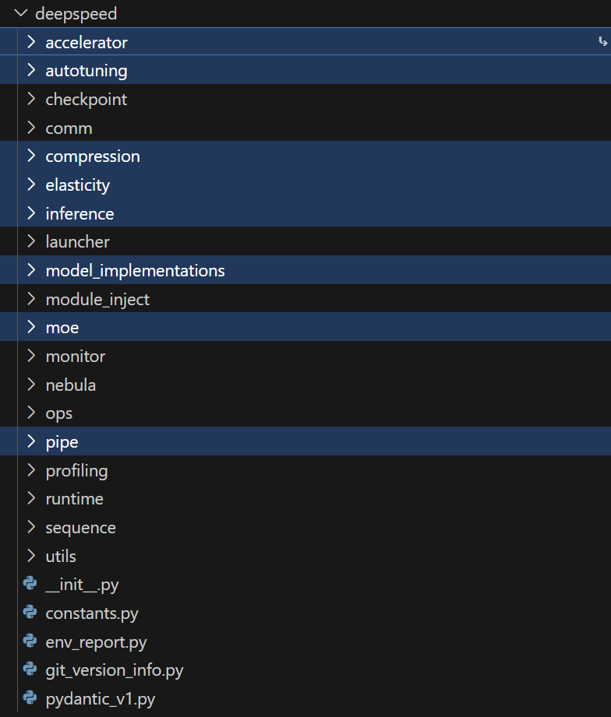
deepspeed
Get out

Slide 26
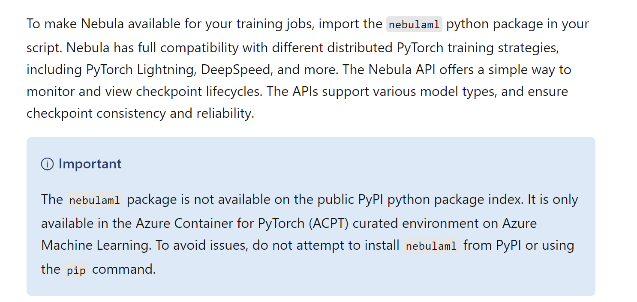
More Stripping: What is Nebula?
LOL get out
https://learn.microsoft.com/en-us/azure/machine-learning/reference-checkpoint-performance-for-large-models?view=azureml-api-2&tabs=PYTORCH

Slide 27
deepspeed/sequence?
Implements DistributedAttention

Slide 28
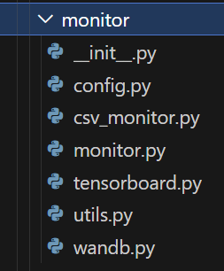
deepspeed/monitor, profiling,
Very important, but maybe not now before algorithm review

Slide 29
deepspeed/module_inject
Bunch of monkeypatching for transformer arch
Don’t need for training (I suspect…)

Slide 30
deepspeed/pipe
Pipeline parallelism

Slide 31
Let’s run MNIST with 2 gpus LOL

Slide 32
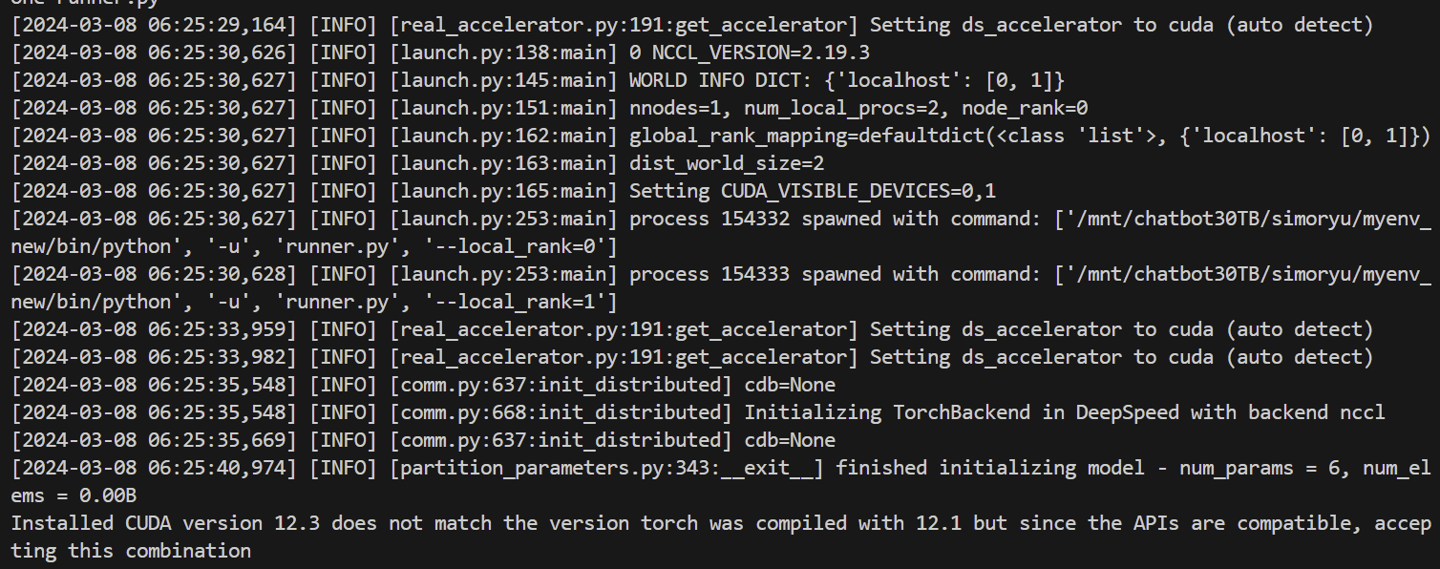




Let’s go!
We see bunch of files…

Slide 33
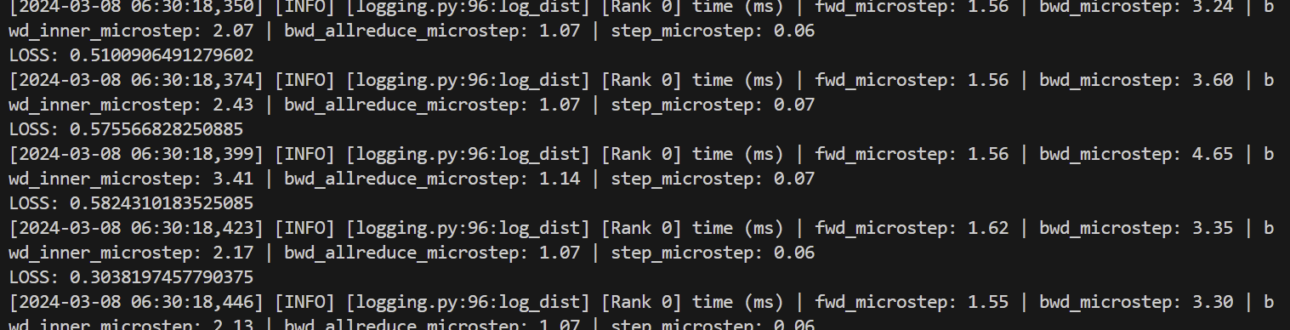
Whoa wait wait

Slide 34
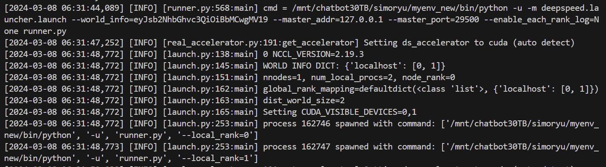
Let’s analyze step by step.
First we see that, because we are using deepspeed launcher,
launch.py handles stuff.

Slide 35
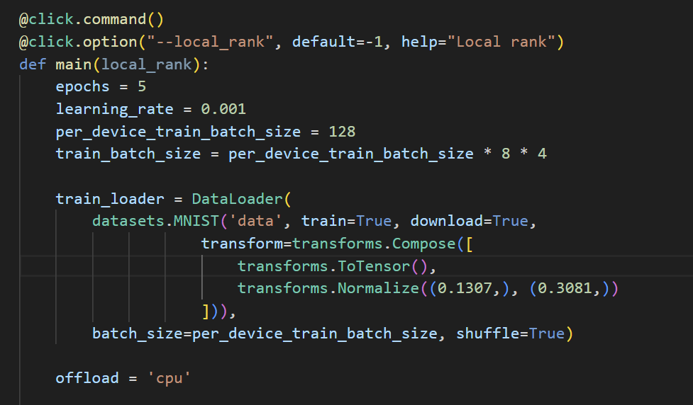
Aha, this explains why we need @click (or argparse)
Launch code individually runs script per-gpu, with arguments in form of cli with them, especially local-rank,

Slide 36
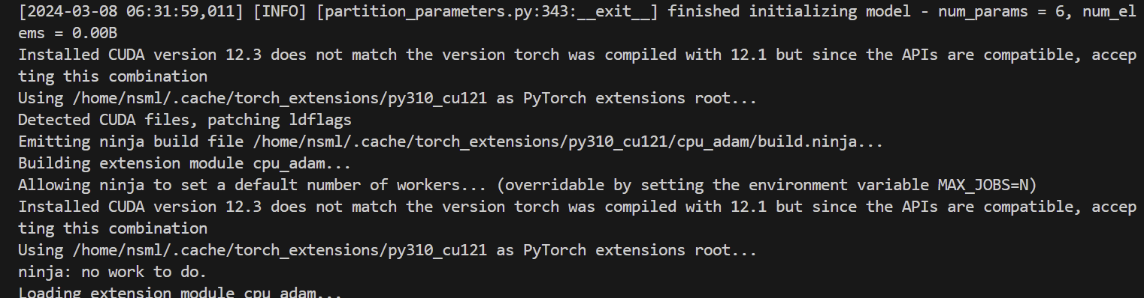

Next, we see partition_parameters.py doing zero-stuff.
+ building cpu-adam because we are using offload (zero-3)
But since I already used it before, I returns the existing build.

Slide 37
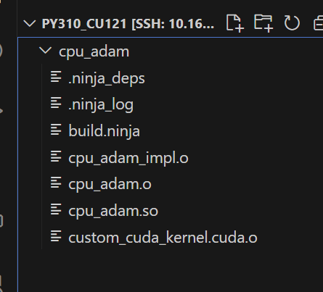
What is in py310-cu121?
Aha, so op_builders returned their shared-object files, and saved it in torch-extention.

